Slide 1

Using Data Science to Analyze the Neighborhoods of Rio de Janeiro
Wanderson Torres

Slide 2

Introduction
Interest in moving to Rio de Janeiro, Brazil
Focus: HEALTH
Where is the safest neighborhood in Rio de Janeiro?
What are the top neighborhoods with the most Heath Services Venues?
Wanderson Torres

Slide 3
The Problem
Health
Services
Points
Risk
to get
COVID
Wanderson Torres

Slide 4
Data Sources
Rio de Janeiro Neighborhoods : Web scrape Wikipedia + Geopy
Covid Dataset: RIO DATA Website
Rio de Janeiro Population: RIO DATA Website
Health Services Venues: Foursquare API
Rio de Janeiro Geodata : Geojson from RIO DATA Website -> Choropleth Map with FOLIUM
Wanderson Torres

Slide 5
Data Cleaning into the COVID Rio Dataset
Limited covid dataset from march, 2020 to april 15 2021
243,790 rows and 5 columns
Drop around 20,000 records with incorrect neighborhood
Feature Selection:
Drop columns with the redundancy information
Sex
Age Group
Race
Keep: Case Evolution (Active, Recovered and Deaths)
Wanderson Torres

Slide 6
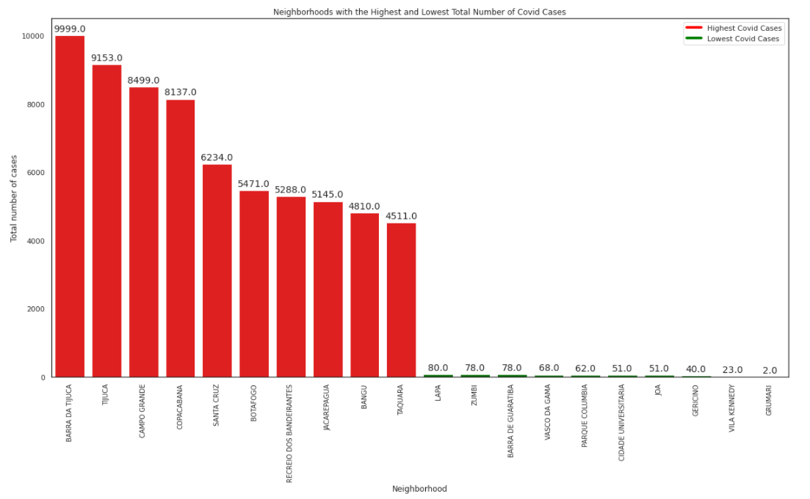
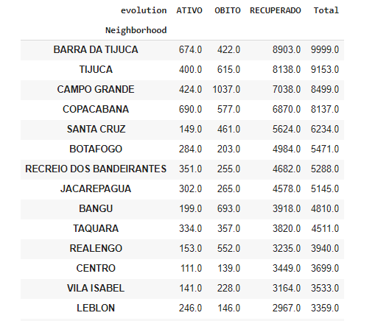
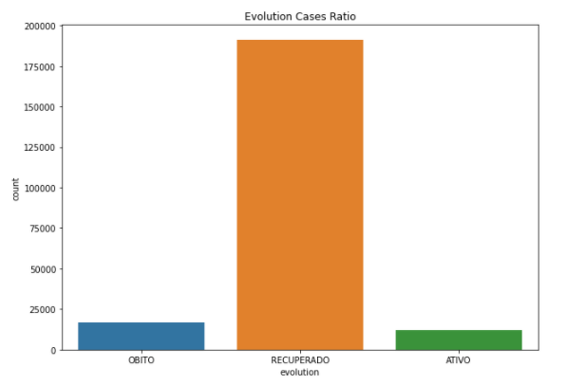
Exploratory Data Analysis
Wanderson Torres

Slide 7
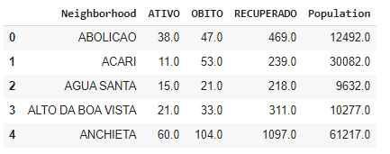
One Hot Encoding and Merge Datasets
Transform the COVID Dataset and merge with the population
Wanderson Torres

Slide 8
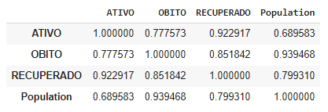
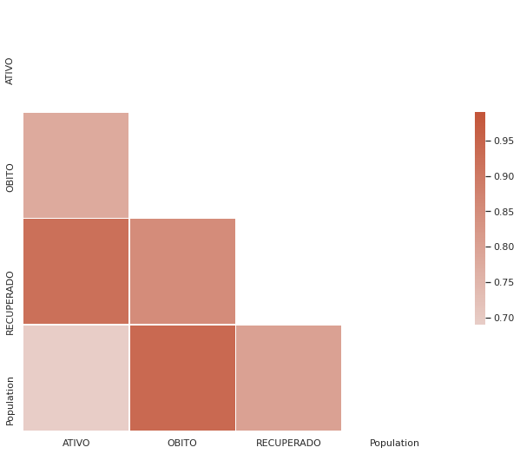
Analyzing the Correlation
Wanderson Torres

Slide 9
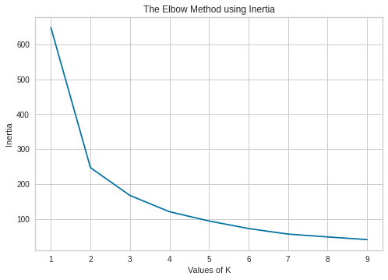
Cluster the Neighborhoods
Find the best number of Clusters
Elbow Method:
Find the best number of Clusters
Silhouete Score:
N_cluster: 2, score: 0.7882471425894928
N_cluster: 3, score: 0.5106348057892676
N_cluster: 4, score: 0.515152346058788
N_cluster: 5, score: 0.4977375527013884
N_cluster: 6, score: 0.5009512483000026
N_cluster: 7, score: 0.46409363723427893
Wanderson Torres

Slide 10
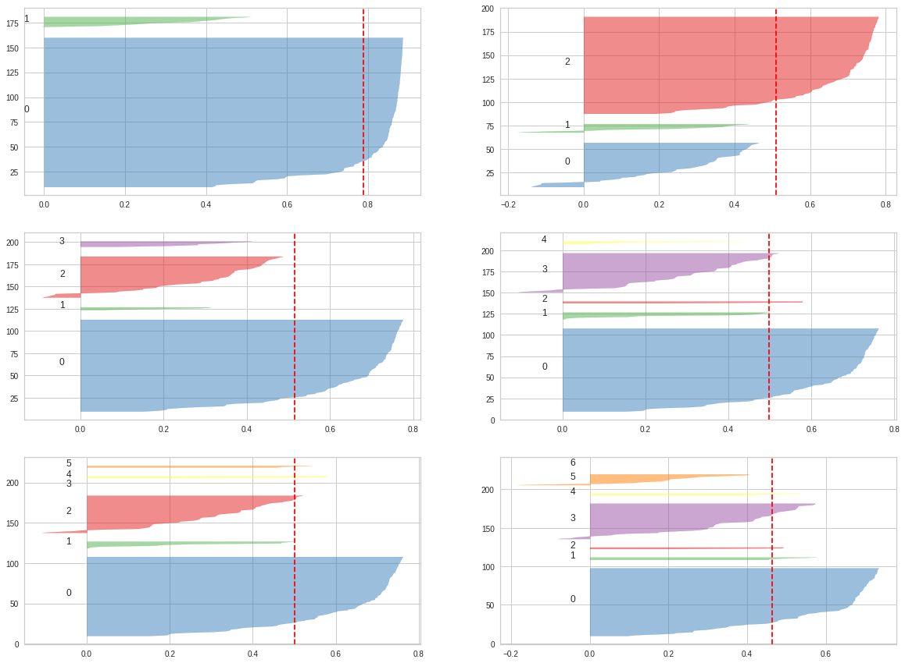
Find the best number of Clusters
Silhouete Visualizer
K = 2
K = 3
K = 4
K = 5
K = 6
K = 7
Wanderson Torres

Slide 11
K-means Clustering
What is it and why use it? Unsupervised learning algorithm that will be used to group or clustering a large covid dataset to identify neighborhoods based on safety.
All the preparation in the dataset for the algorithm have already done.
Choose to group in 6 clusters.
Wanderson Torres

Slide 12
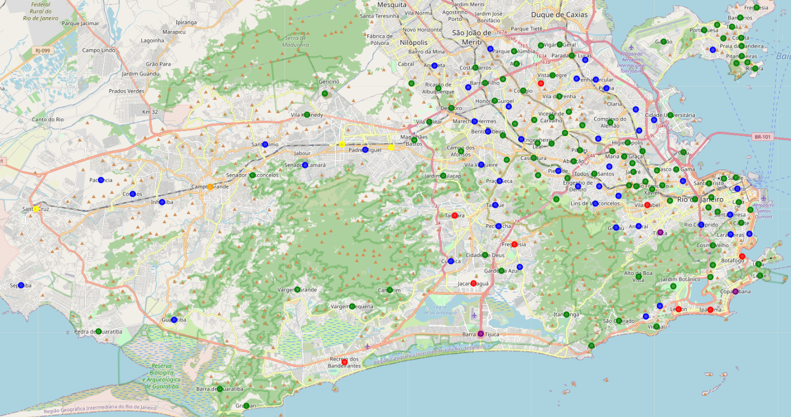
Result from k-means clustering
Cluster 0 → green Cluster 2 → blue Cluster 4 → purple
Cluster 1 → red Cluster 3 → Orange Cluster 5 → yellow
Wanderson Torres

Slide 13
Analyzing the Clustering
Cluster 3 (orange)
1 Neighborhood (Campo Grande)
Highest Neighborhood's population
Middle number of COVID cases
High number of Deaths
Cluster 4 (purple)
Few Neighborhoods
High Neighborhood's population
High number of COVID cases
Low number of Deaths
Cluster 5 (yellow)
Few Neighborhoods
High Neighborhood's population
Middle number of COVID cases
High number of Deaths
Cluster 0 (green)
Many neighborhoods
Neighborhood's population is low
Low number of COVID cases
Cluster 1 (red)
Few Neighborhoods
Neighborhood’s population is high
High number of COVID cases
Cluster 2 (blue)
Many Neighborhoods
Middle Neighborhood's population
Middle number of COVID cases
Wanderson Torres

Slide 14
Create the COVID RISK INDEX (CRI)
The covid risk index is an indicator that considers 3 variables:
1. The number of active COVID cases by the population.
2. Number of deaths by COVID by the total number of COVID cases.
3. Total number of COVID cases by the population.
CRI = 1 + 2 + 3
Wanderson Torres

Slide 15
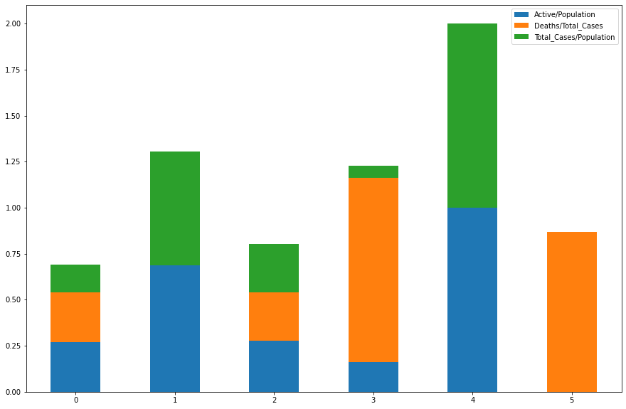
COVID RISK INDEX (CRI) Analysis
Now, with CRI, I can better assess the risk of COVID per cluster.
We can see the highest CRI value belongs to cluster 4 .
That means the cluster has a High Risk to COVID.
Cluster | CRI
Cluster 0 | 0.69
Cluster 2 | 0.80
Cluster 5 | 0.87
Cluster 3 | 1.23
Cluster 1 | 1.30
Cluster 4 | 2.00
Wanderson Torres

Slide 16
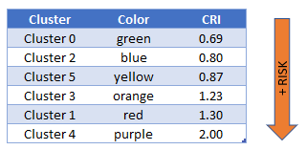
Result from k-means clustering
Wanderson Torres

Slide 17
Explore the neighborhoods with health services in Rio de Janeiro using Foursquare API
Medical Center
Acupuncturist
Alternative Healer
Chiropractor
Dentist's Office
Doctor's Office
Emergency Room
Eye Doctor
Hospital
Hospital Ward
Maternity Clinic
Medical Lab
Mental Health Office
Nutritionist
Physical Therapist
Rehab Center
Urgent Care Center
Drugstore
Health & Beauty Service
Massage Studio
Medical Supply Store
Pharmacy
Spa
Supplement Shop
Health & Beauty Service
Health Food Store
26 Foursquare Categories
Wanderson Torres

Slide 18
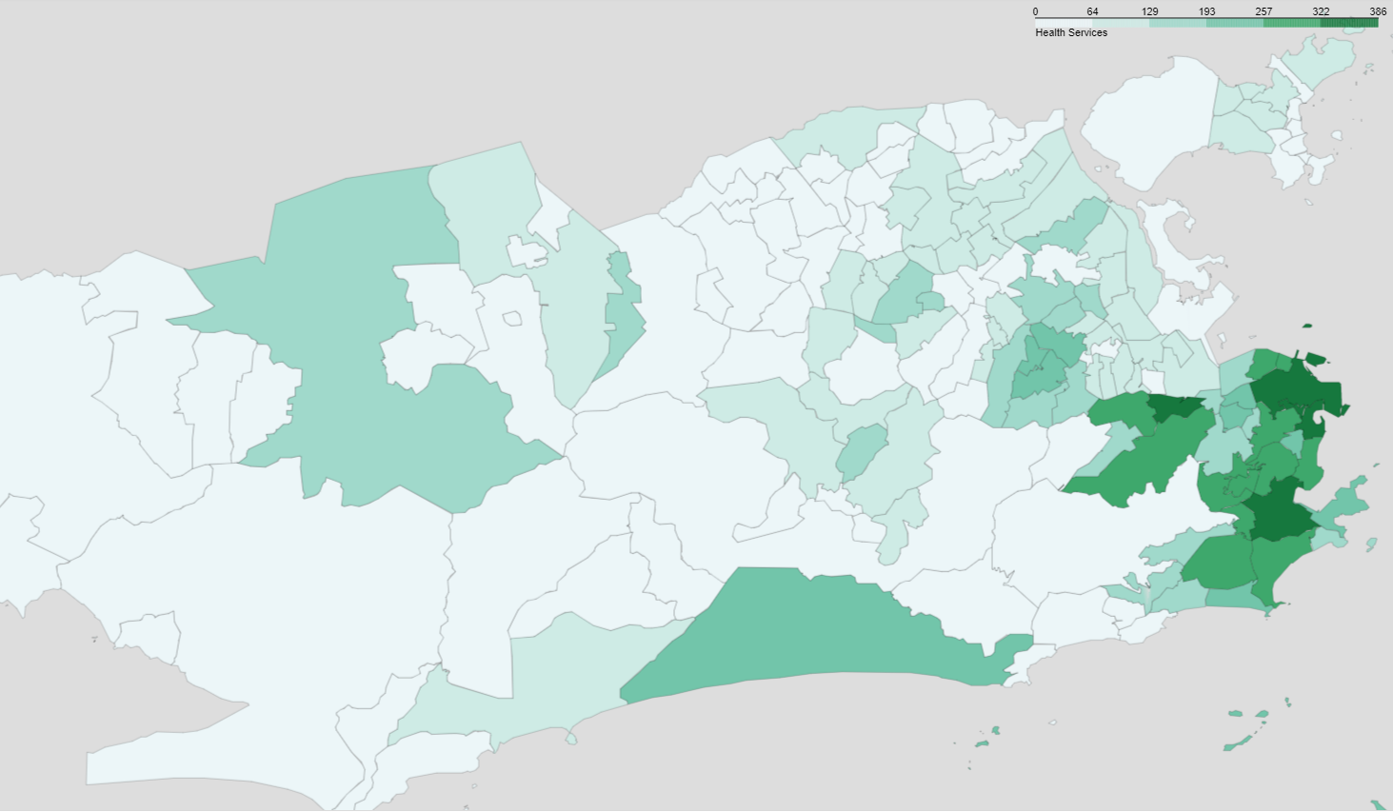
Explore the neighborhoods with health services in Rio de Janeiro using Foursquare API
Create the Choropleth Map using FOLIUM python library with the number of health services points like hospitals, clinics, drugstores, medical offices,…
Wanderson Torres

Slide 19
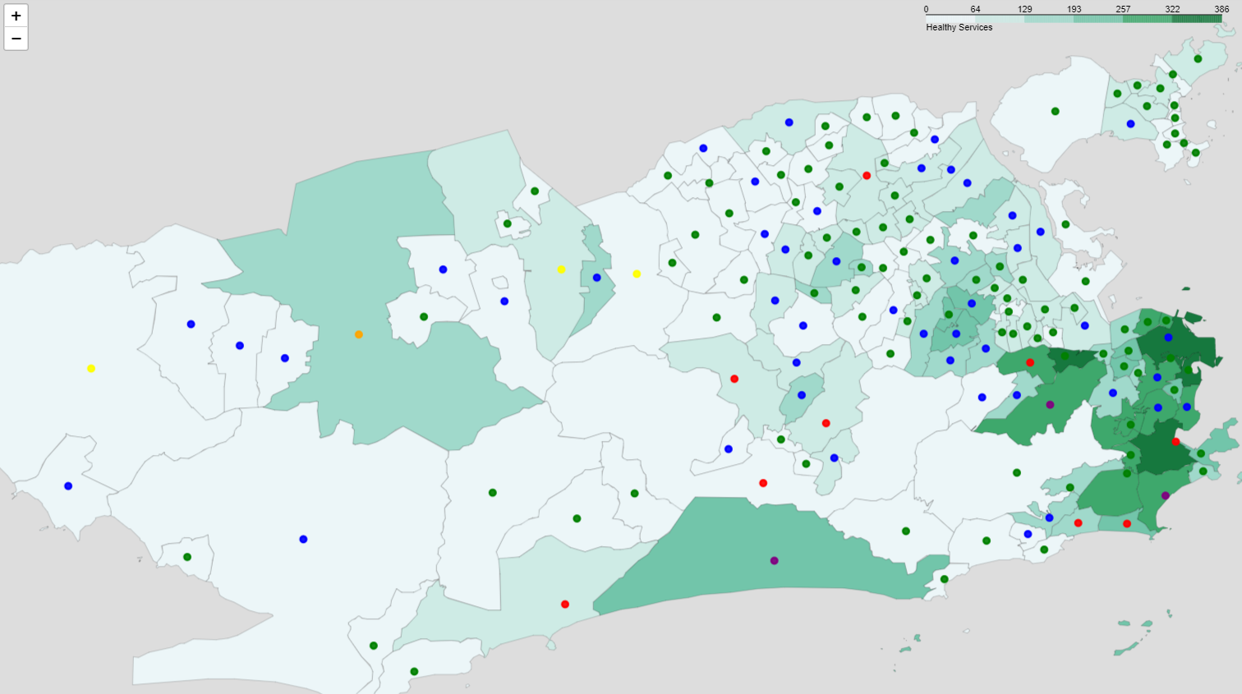
Choose a safer place to live
Combining the COVID risk clustering and the health service offerings
Wanderson Torres

Slide 20
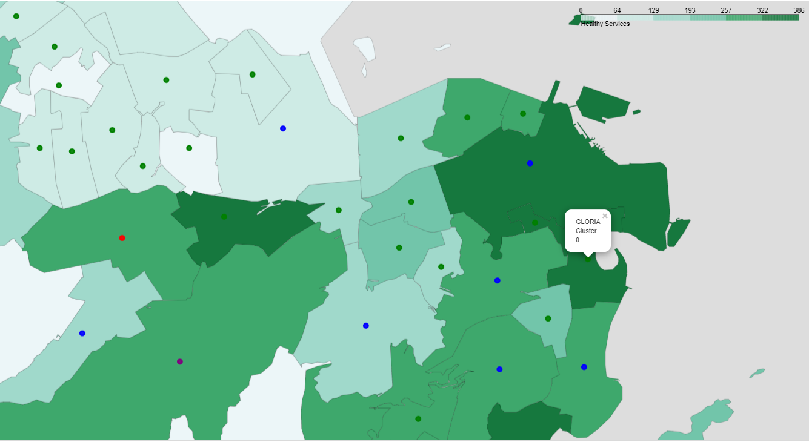
Choose a safer place to live
Getting deeper in the dark green areas
Wanderson Torres

Slide 21
Summary / Conclusion
Six clusters were identified by K-means algorithm.
The Covid risk index (CRI) were created to compare the clusters.
Safest Cluster to live in: Cluster 0
2 best options of Neighborhoods considering the CRI and Heath Services offerings: LAPA and GLÓRIA
Discussions points:
Underreporting in poor areas
Foursquare is not very famous in Brazil
Futures Analysis:
Include the sex, age group and race features of COVID cases x Neighborhoods
Use other algorithms and compare the results
Wanderson Torres

